Slide 1

TEAM A
IN ACTION
MAJOR PROJECT
Analyzing the Campaign Data from Banco de Portugal
PREDICTIVE MODELING OF
BANK MARKETING CAMPAIGN SUCCESS

Slide 2

Understanding Bank Marketing Campaigns
Overview:
Direct Marketing Campaigns: Financial institutions rely on direct marketing campaigns to promote products like term deposits, loans, or credit cards. A common strategy involves phone outreach to potential clients, aiming to convert leads into customers.
Customer Behavior & Preferences: The success of these campaigns depends on understanding customer behavior. Identifying patterns in customer preferences allows banks to target specific segments more effectively.
Challenges:
Client Engagement: Multiple calls may cause customer fatigue, reducing positive responses. Finding the right balance is key.
Data Management: Handling large volumes of client data requires robust systems for better targeting.
Predictive Accuracy: Predicting customer behavior is complex and influenced by many factors, requiring accurate models.
Regulatory Compliance: Banks must follow strict data privacy regulations while conducting marketing efforts.

Slide 3

Project Objective
Objective:
The primary objective of this project is to analyze the marketing campaign data provided by Banco de Portugal. The goal is to predict whether a client will subscribe to a term deposit based on various demographic, economic, and campaign-related features.
Goal:
Develop a Predictive Model: This project aims to build a classification model that can accurately predict binary outcomes—whether a client will say "yes" or "no" to subscribing to a term deposit.
Enhance Marketing Efficiency: By identifying the factors that lead to a successful campaign, banks can optimize future marketing efforts, focusing on clients who are more likely to respond positively.

Slide 4
Dataset Overview
 | age | job | marital | education | default | housing | loan | contact | month | day_of_week | duration | campaign | pdays | previous | poutcome | emp.var.rate | cons.price.idx | cons.conf.idx | euribor3m | nr.employed | y
0 | 56 | housemaid | married | basic.4y | no | no | no | telephone | may | mon | 261 | 1 | 999 | 0 | nonexistent | 1.1 | 93.994 | -36.4 | 4.857 | 5191.0 | no
1 | 57 | services | married | high.school | unknown | no | no | telephone | may | mon | 149 | 1 | 999 | 0 | nonexistent | 1.1 | 93.994 | -36.4 | 4.857 | 5191.0 | no
2 | 37 | services | married | high.school | no | yes | no | telephone | may | mon | 226 | 1 | 999 | 0 | nonexistent | 1.1 | 93.994 | -36.4 | 4.857 | 5191.0 | no
3 | 40 | admin. | married | basic.6y | no | no | no | telephone | may | mon | 151 | 1 | 999 | 0 | nonexistent | 1.1 | 93.994 | -36.4 | 4.857 | 5191.0 | no
4 | 56 | services | married | high.school | no | no | yes | telephone | may | mon | 307 | 1 | 999 | 0 | nonexistent | 1.1 | 93.994 | -36.4 | 4.857 | 5191.0 | no
5 | 45 | services | married | basic.9y | unknown | no | no | telephone | may | mon | 198 | 1 | 999 | 0 | nonexistent | 1.1 | 93.994 | -36.4 | 4.857 | 5191.0 | no
6 | 59 | admin. | married | professional.course | no | no | no | telephone | may | mon | 139 | 1 | 999 | 0 | nonexistent | 1.1 | 93.994 | -36.4 | 4.857 | 5191.0 | no
7 | 41 | blue-collar | married | unknown | unknown | no | no | telephone | may | mon | 217 | 1 | 999 | 0 | nonexistent | 1.1 | 93.994 | -36.4 | 4.857 | 5191.0 | no
8 | 24 | technician | single | professional.course | no | yes | no | telephone | may | mon | 380 | 1 | 999 | 0 | nonexistent | 1.1 | 93.994 | -36.4 | 4.857 | 5191.0 | no
9 | 25 | services | single | high.school | no | yes | no | telephone | may | mon | 50 | 1 | 999 | 0 | nonexistent | 1.1 | 93.994 | -36.4 | 4.857 | 5191.0 | no

Slide 5
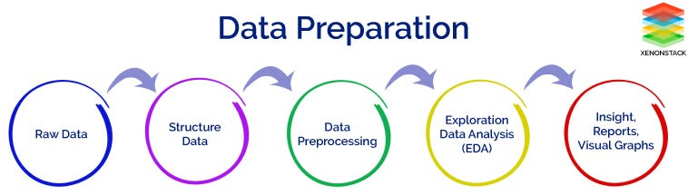

Data Preparation:
Data Preparation is essential to ensure data quality and improve model accuracy. By cleaning, handling missing values, and removing irrelevant features, it prevents biased or misleading results. Properly scaled and encoded data ensures compatibility with machine learning algorithms, leading to more reliable and generalizable models. Overall, data preparation lays the foundation for successful analysis and model performance.
Data Cleaning: Handling missing values.
Target Variable Encoding: “y” converted to binary (1/0).
Dropping Non-Predictive Features: Dropped duration.

Slide 6

Feature Engineering:
Feature engineering is the process of transforming raw data into meaningful features that improve the performance of machine learning models. It involves identifying, or modifying features to make the data more useful for analysis.
Feature identification: It involves categorizing features as numerical (quantitative data like age or salary) or categorical (qualitative data like gender or country). This distinction is crucial because numerical features may need scaling, while categorical ones require encoding for machine learning models to process them effectively.
Scaling: Normalizing or standardizing numerical data so that all features have similar scales, improving model performance.
Encoding Categorical Variables: Converting categories into numerical values using methods like one-hot encoding, allowing models to process non-numeric data.
Choosing Relevant Features: Identifying which features have the most predictive power, eliminating irrelevant or redundant data to reduce noise and improve accuracy.
.

Slide 7

Model Evaluation
Model evaluation refers to the process of assessing the performance of a machine learning model using various metrics to determine its accuracy and effectiveness in making predictions. This step is crucial as it helps to identify how well the model generalizes to unseen data, guiding further improvements and ensuring reliable predictions.
Performance Metrics:
Accuracy: Measures the overall correctness of the model's predictions.
Precision: Indicates the proportion of true positive results in all positive predictions (True Positives / (True Positives + False Positives)).
Recall (Sensitivity): Reflects the model's ability to identify all relevant instances (True Positives / (True Positives + False Negatives)).
F1-Score: The harmonic mean of precision and recall, balancing the two metrics (2 * (Precision * Recall) / (Precision + Recall)).
.

Slide 8
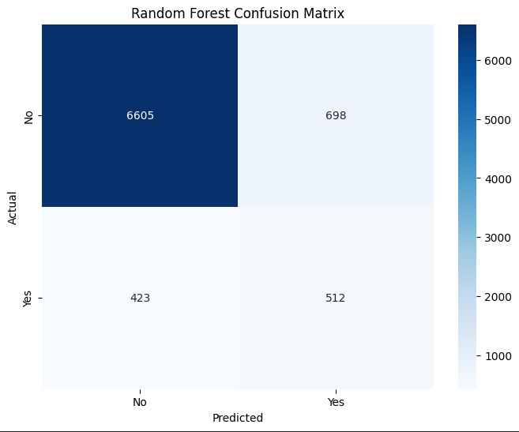
Confusion Matrix Interpretation
A confusion matrix is a tabular representation of a classification model's performance, showing the actual versus predicted classifications. It summarizes the correct and incorrect predictions made by the model, allowing for a clear assessment of its performance across different classes.
Interpretation:
True Negatives (TN): 6605
These are the cases where the model correctly predicted that a client would not subscribe to a term deposit.
False Positives (FP): 698
These are the cases where the model incorrectly predicted that a client would subscribe (predicted Yes) when they actually did not (Actual No).
False Negatives (FN): 423
These are the cases where the model incorrectly predicted that a client would not subscribe (predicted No) when they actually did (Actual Yes).
True Positives (TP): 512
These are the cases where the model correctly predicted that a client would subscribe.
.

Slide 9
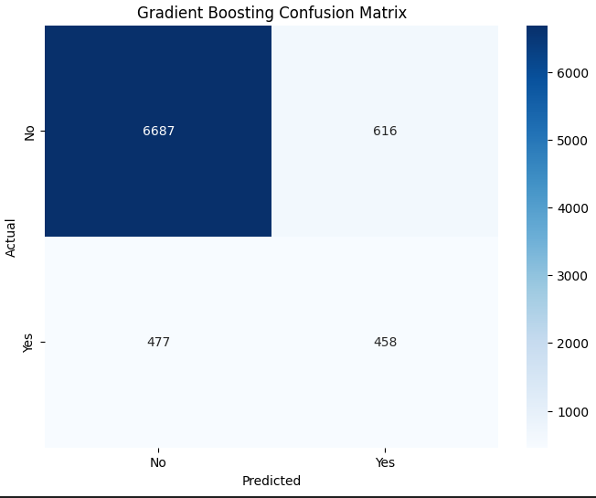
True Negatives (TN): 6687
The model correctly predicted that a client would not subscribe.
False Positives (FP): 616
The model incorrectly predicted that a client would subscribe.
False Negatives (FN): 477
The model incorrectly predicted that a client would not subscribe.
True Positives (TP): 458
The model correctly predicted that a client would subscribe.
.

Slide 10
Feature Importance:
Feature importance refers to the technique used to determine the significance or influence of each feature (input variable) in a machine learning model regarding its predictions. It quantifies how much each feature contributes to the model's ability to predict the target variable.
Features selected in our dataset were:
'age','job','marital','education','housing', 'day_of_week',
'campaign','pdays','poutcome','emp.var.rate','cons.price.idx’,
'cons.conf.idx','euribor3m','nr.employed'
.

Slide 11
Conclusion:
Key Findings:
Random Forest Model: Developed a successful Random Forest model to predict client subscription to term deposits with strong accuracy.
Feature Importance: Identified critical factors influencing clients' choices, such as demographic data, previous interactions, and financial attributes.
Implications for Marketing:
Enhanced Targeting: The insights derived from the model can be used to create highly targeted marketing campaigns, focusing on customer segments most likely to subscribe to term deposits.
Improved Campaign Efficiency: With more accurate targeting, marketing efforts can become more cost-effective, potentially boosting campaign success rates and overall return on investment.

Slide 12

Future Work
Suggestions for Model Enhancement:
Additional Feature Engineering: Conduct deeper feature engineering to discover more complex interactions between variables, such as creating new features from existing data or incorporating external data (e.g., economic indicators or customer behavior patterns).
Ensemble Methods: Explore the use of other ensemble methods such as Gradient Boosting or XGBoost to potentially improve prediction accuracy and model robustness. Ensemble stacking might also combine multiple models for better performance.
Hyperparameter Tuning: Optimize model performance by tuning hyperparameters using techniques like Grid Search or Random Search.
[Number of trees (n_estimators), Maximum depth (max_depth), Learning rate ]
Real-time Data Integration: Consider integrating real-time data to make the model more adaptive, enabling dynamic predictions and personalized marketing strategies that respond to changes in customer behavior instantly.

Slide 13

Any Question?

Slide 14



